Slide 1

PlayLocal
Don't Just Book a Game. Build a Community

Slide 2



TODAY'S AGENDA
1
Introduction About PlayLocal
6
Competitive Advantage (USP)
2
Problem Statement
7
Market & Competitors
3
Our Solution
Revenue Model
8
4
Target Market
Development Roadmap
9
5
Key Features
Closing
10

Slide 3
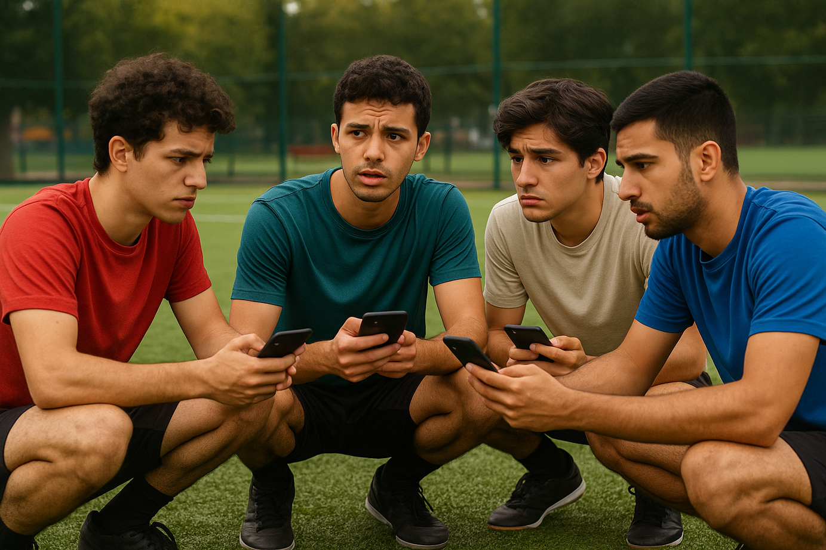

Difficulty in organizing and booking amateur sports games
Hard to find replacement players for last-minute cancellations
Venue owners lack digital tools for efficient booking and management
Existing solutions focus only on transactions, ignoring the social aspect
Problem Statement

Slide 4







Our Innovative Solutions
A comprehensive platform
Powerful tools
Data analytics
focused on building a sports community and Social features to connect players
for players and venue owners to increase engagement and revenue
to prove platform value to venue owners

Slide 5



TARGET MARKET
-Launch in Greater Cairo
-High demand for football & booming interest in padel tennis, basket , tennis, volley ball
-Hundreds of venues ready for rapid adoption

Slide 6
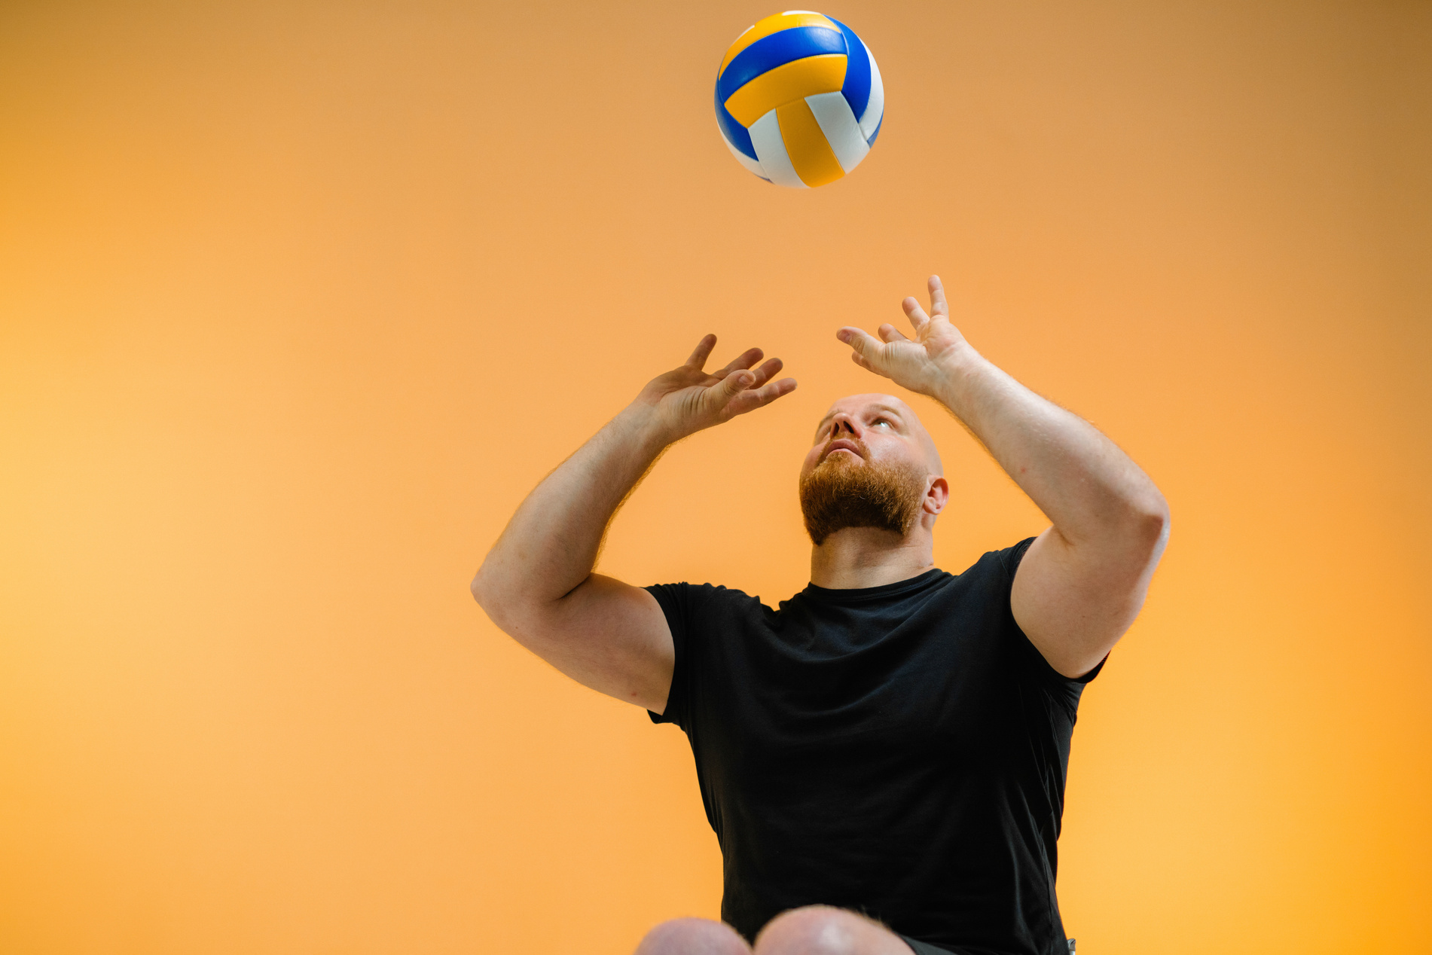
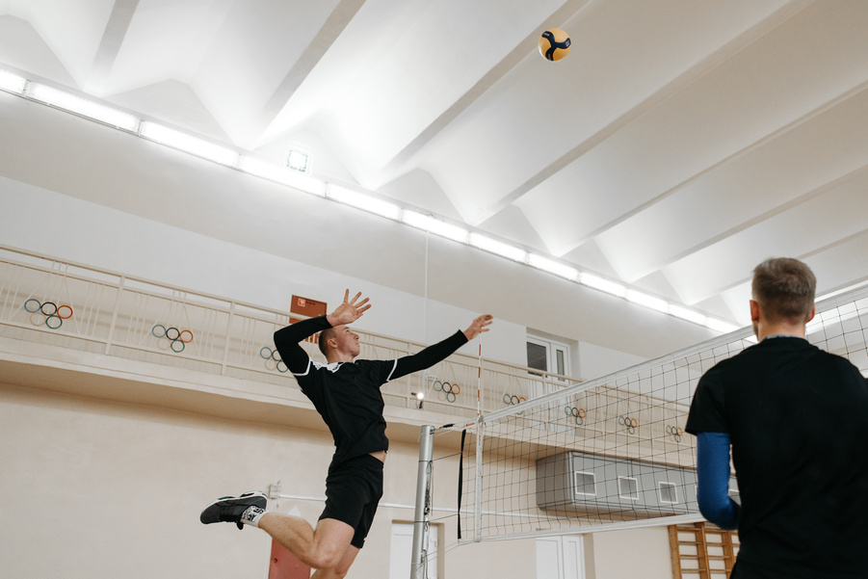
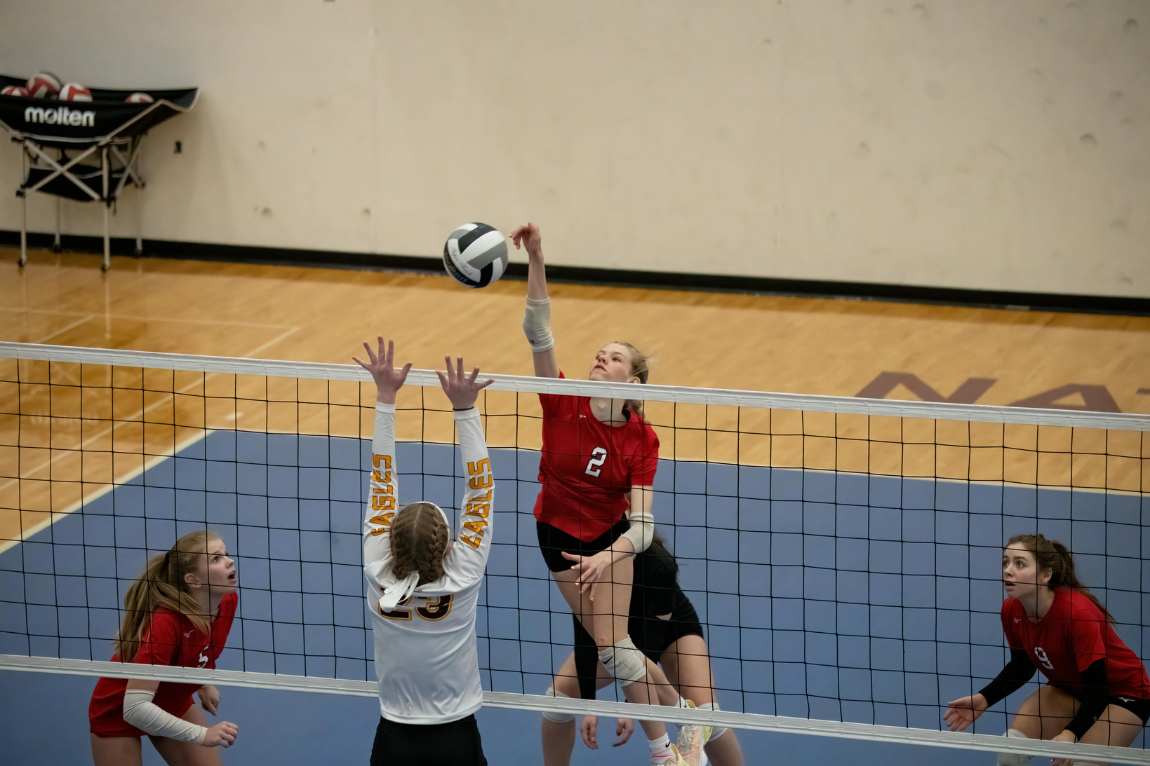
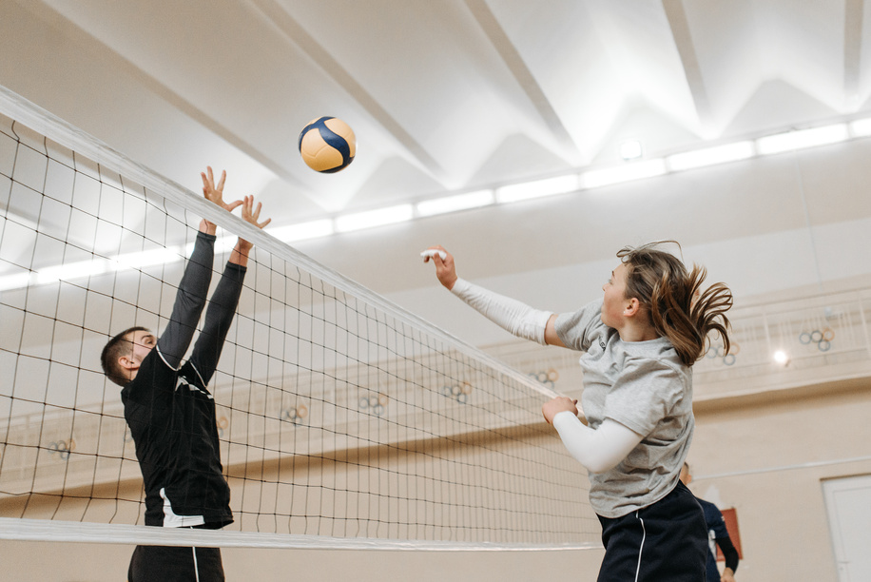
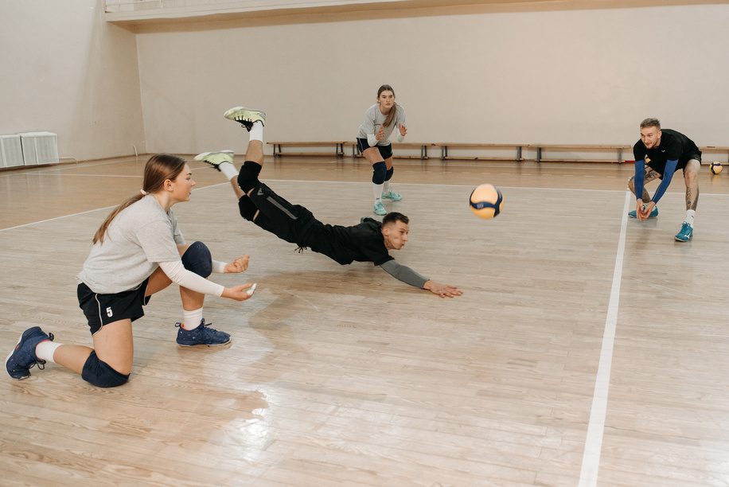
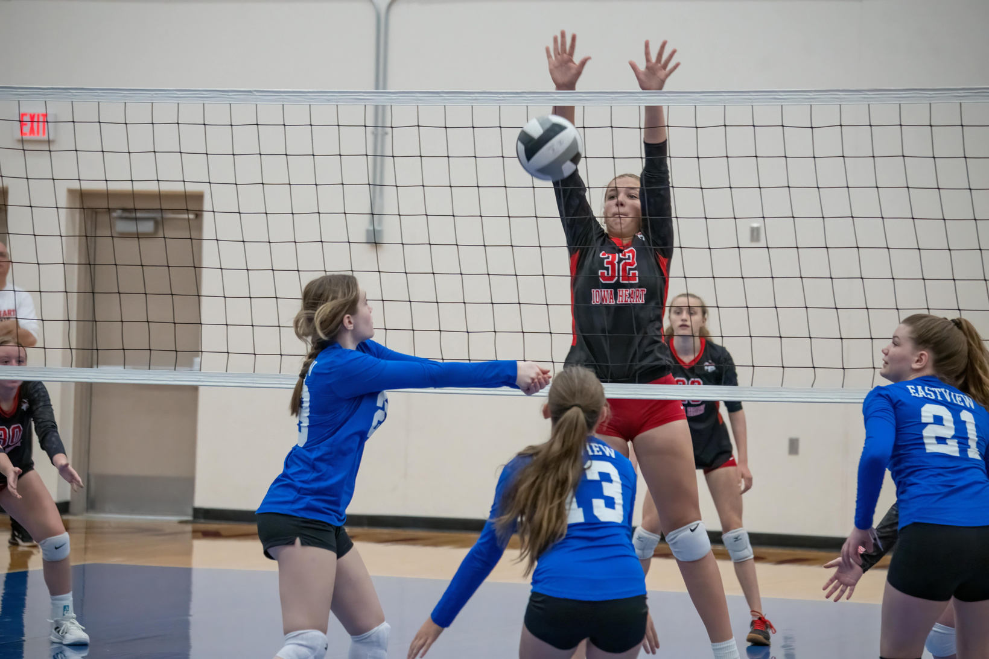
Key Features :
1- for players
1-Easy venue search & booking.
2-Player Finder + creative Player Cards.
3-Venue ratings & amenities.
4-Direct player–venue owner chat.
5-Loyalty discounts & priority booking.
6-Equipment rental.
7-Video training tips.
8-Authentication: unique arrival verification code

Slide 7
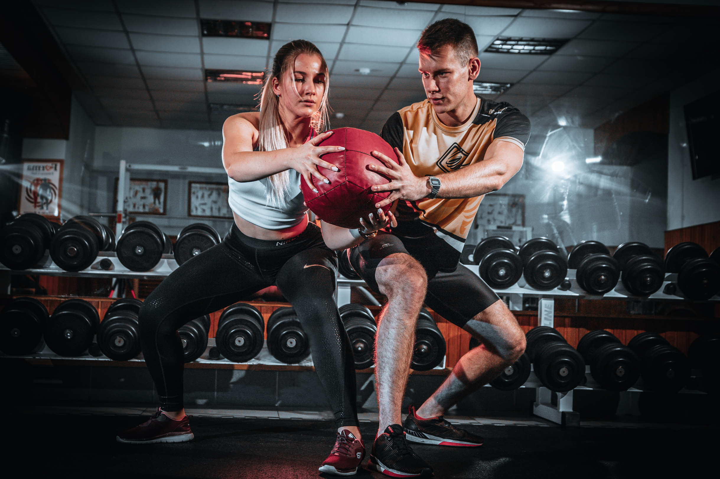
2-For Venue Owners
1-Digital booking & management system.
2-Booking Channel Analysis (PlayLocal vs other channels).
3-Top customer lists for targeted rewards.
4-AI-powered dynamic pricing.
5-Instant cancellation notifications.
6-Discount notifications.
7-Inventory management.

Slide 8
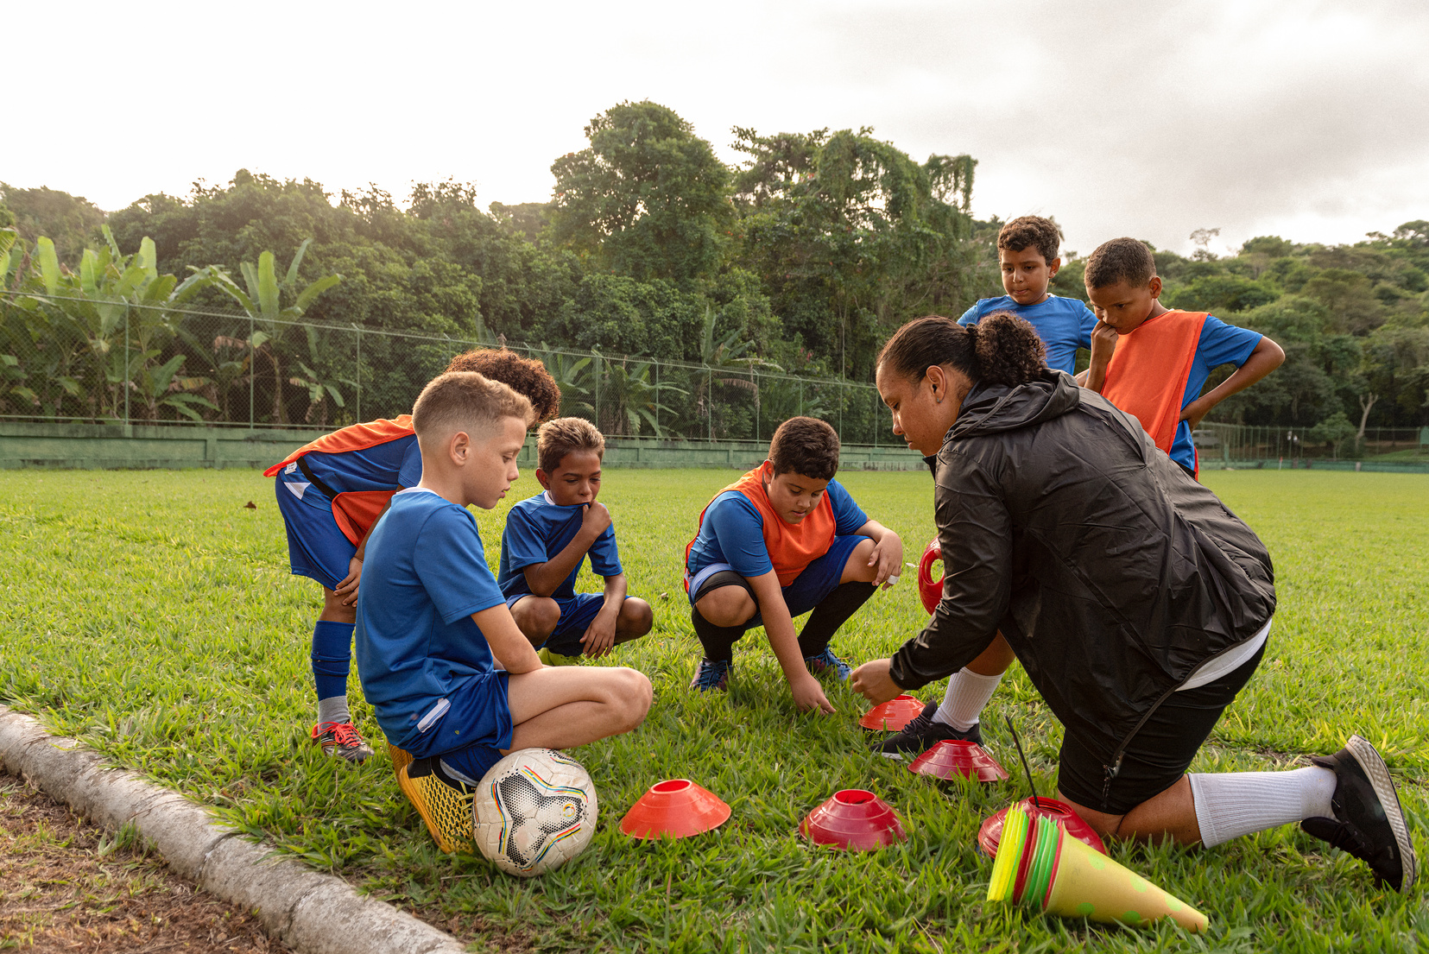
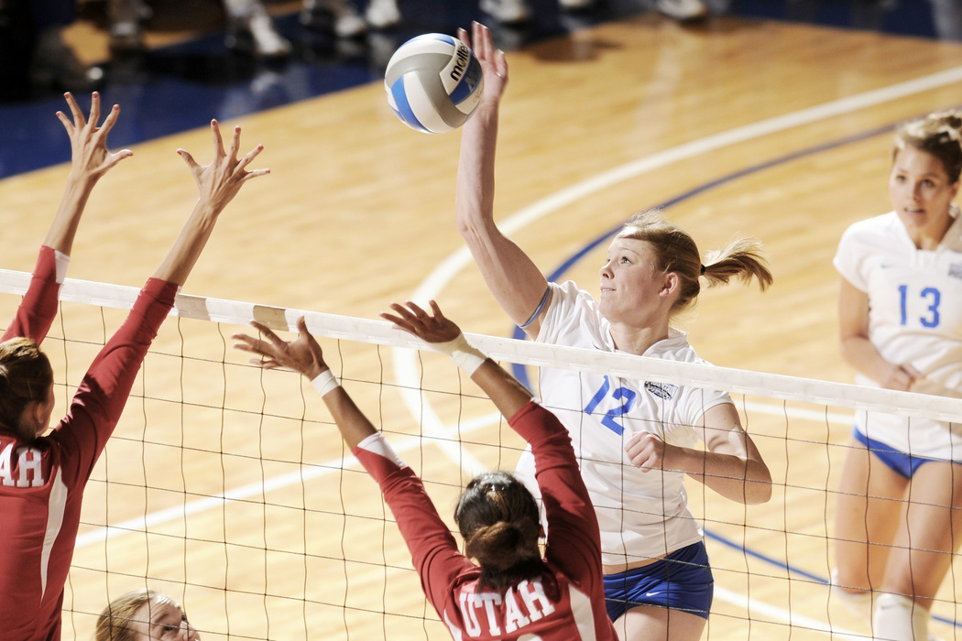

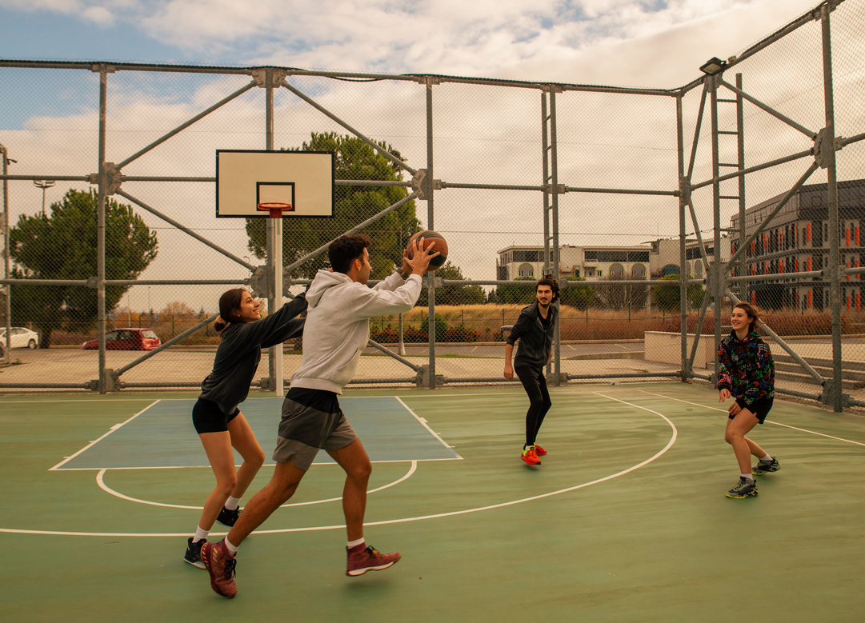
Advanced Features
1- displaying contact info and locations for affiliated Training Academies
2-displaying contact info and locations for sports physical therapists
3-They can also view all on-site amenities, such as cafes or restaurant

Slide 9
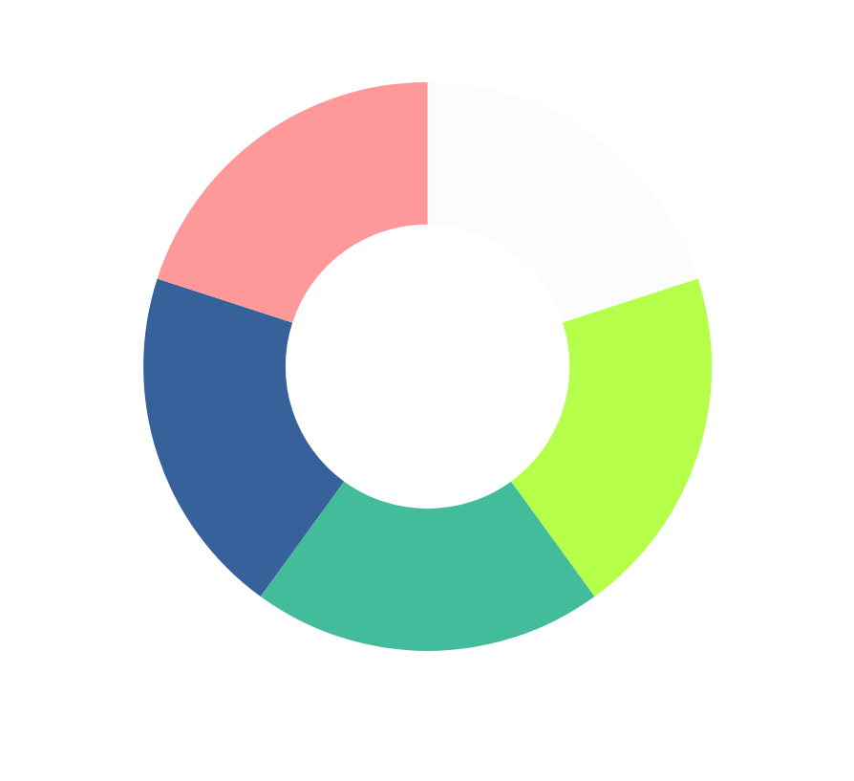

Business Ideas
1-Premium features for venue owners
2-Invitation points
3-Discounts & priority access for frequent players

Slide 10
COMPETITIVE ADVANTAGE (USP)
PlayLocal = community-driven platform + real business value for owners.
Competitors = transaction only
Difficult to replicate due to integrated loyalty & social systems.
Data-driven proof of ROI for owners.

Slide 11
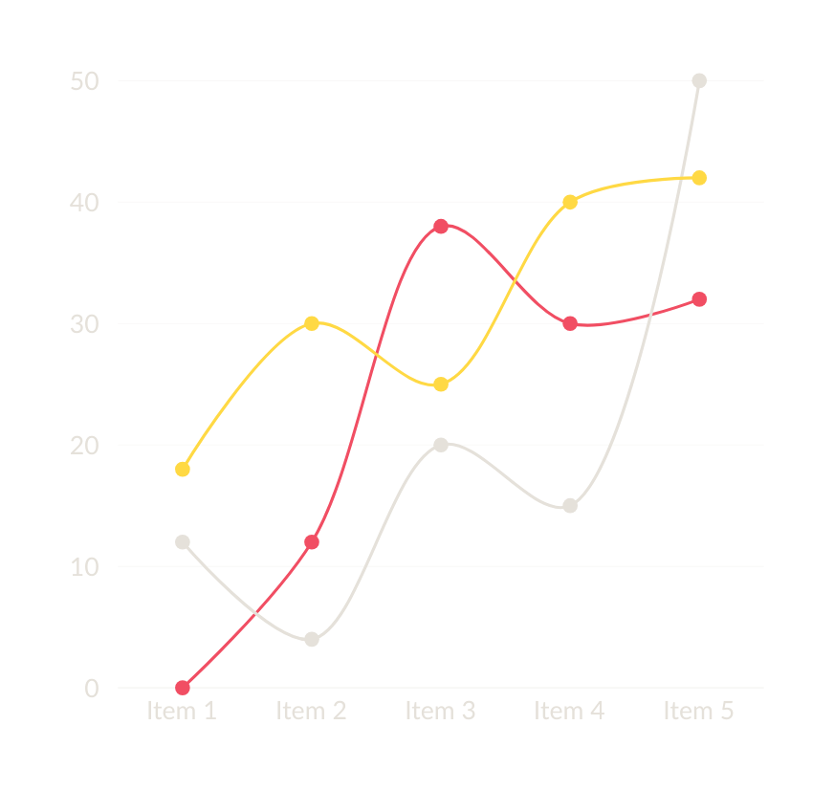
MARKET & OPPORTUNITY
Fast-growing amateur sports market in Egypt
High demand for football & booming interest in padel tennis
Hundreds of venues in Greater Cairo with limited digital tools
Current competitors: Probal, Mal3abak ملاعب مصر, Yalla Hagz

Slide 12
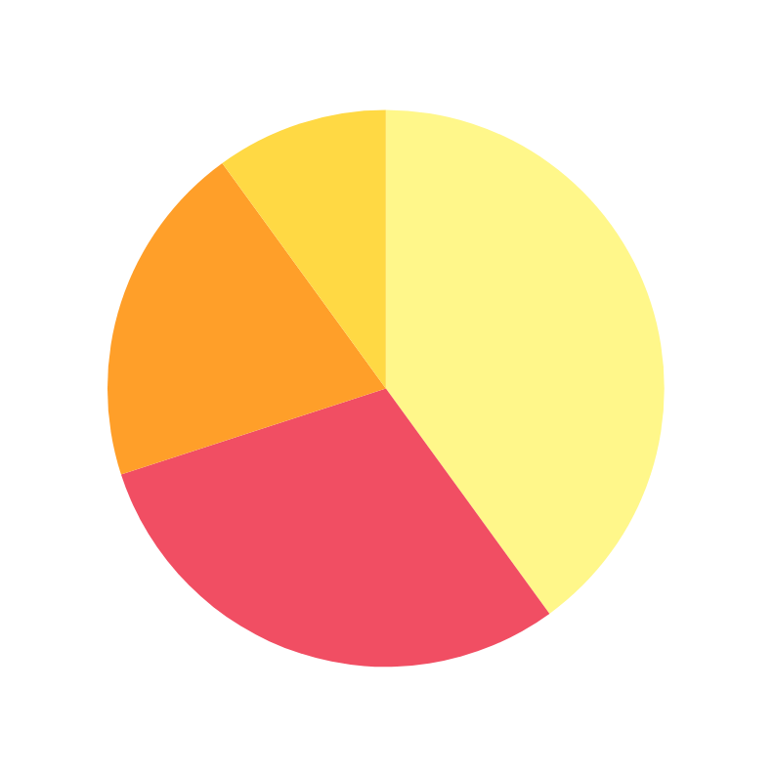
REVENUE MODEL
Commission per booking
Premium subscription (PlayLocal Pro)
Future revenue: e-commerce, academy booking, value-added services

Slide 13
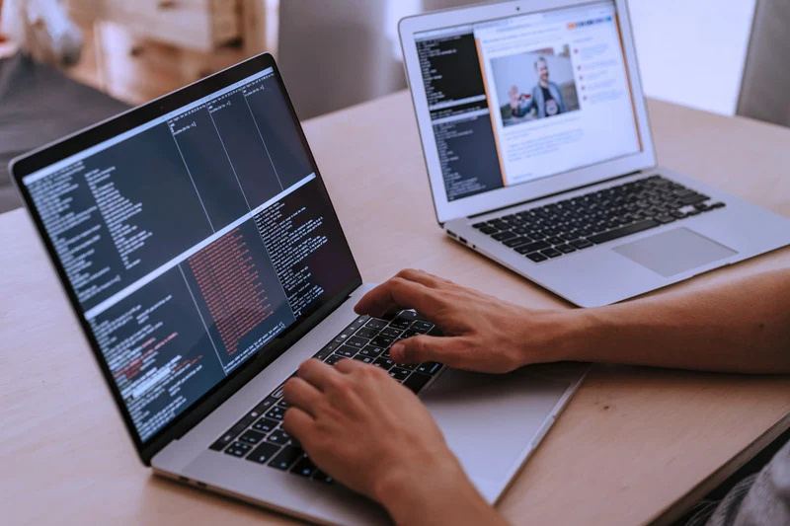
Development Roadmap
Phase 1 : MVP – booking, OTP, profiles, Player Finder, booking analysis
Phase 2 : AI league management, partner academy/physiotherapy directory
Phase 3 : E-commerce store, inventory management, academy

Slide 14


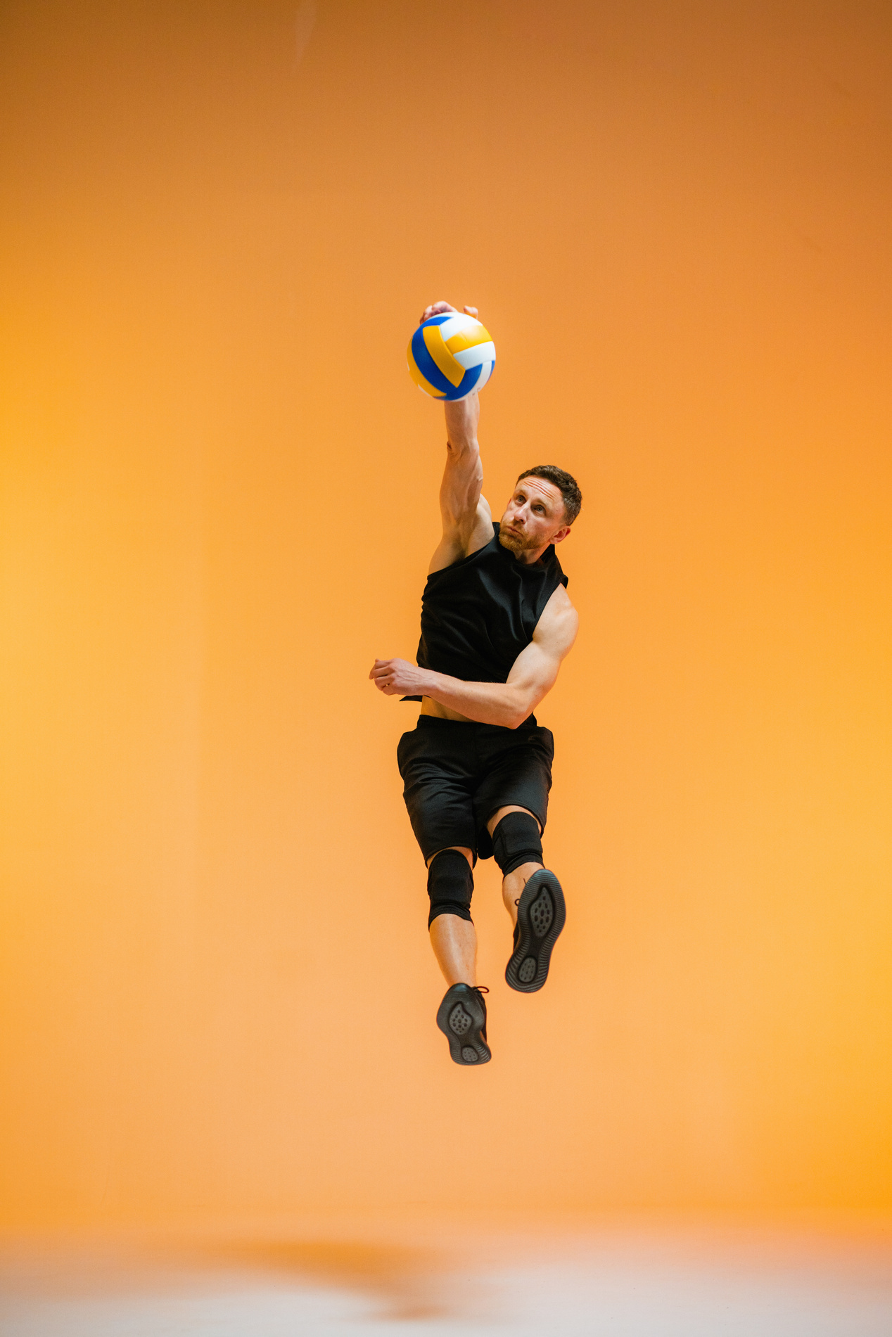
Borcelle
Closing
PlayLocal connects players & venue owners in a complete sports experience.
Mission: Build a strong sports community in Egypt & beyond

Slide 15
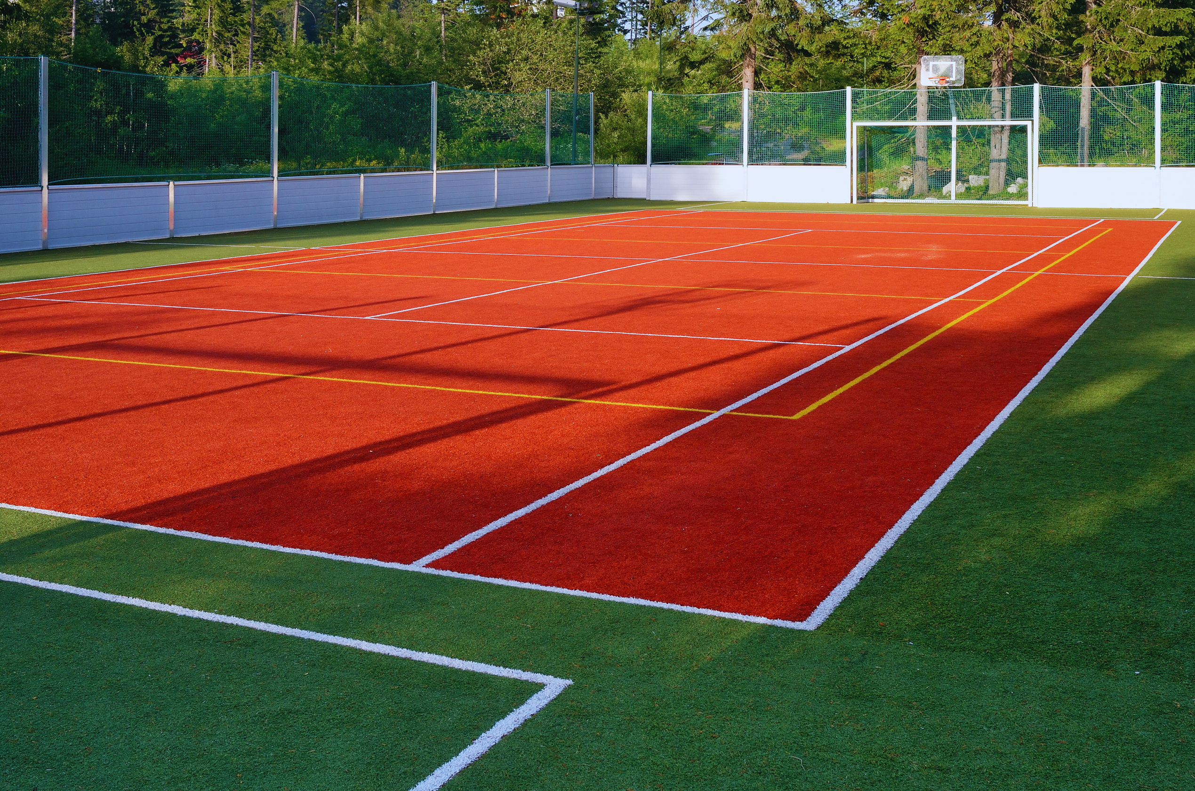

THANK YOU
for your time and attention
Don't Just Book a Game. Build a Community

